Slide 1
PDW Review Of CNW
1/2015

Slide 2
Summary
Recommend 1/4 to 1/2 position – next call/analysts Mtg (end of Jan 15)
Place on a “Watch List” and buy on any corrections (<$45 mid point, 40 to 50)
Missed a great entry point at $40 back at Oct 13, 20-25% run from Oct to current
Not much news, generally positive, anticipate higher earnings/margins in 2015
Current risk/reward at high 40s – down 10 (Oct lows - 40) , up 5 (price targets, 50-51)
Analyst are neutral, stock price targets are ~50-51
Longer term fundamentals look positive, current P/E fully valued, PEG med buy
Solid Midwest US (85 yr old) trucking & logistics, not tied to oil RR tank car Logistics
425 ops locations in US, 20 international (AP, Europe)
Menlo Logistics, HQd in SFO offers international Logistics services
Low debt vs UPS
Excellent list of institutional owners – Vanguard small cap
Tech indicators neutral to close to over bought
Low oil prices (a positive), increasing interest rates/strong dollar (positive - more US commerce & buying power, positive), slowing world economy (neutral – CNW has some non US logistics)
Robert Bassett (CEO), Stephen Bruffett (CFO) & Robert Bianco JR (CEO Menlo & VP Conway) – Midwest folk, well trained, lots of experience in trucking & logistics, long time service w/Conway
Recent CNBC chatter from pundits claiming US trucking has lagged the transports run – they liked Swift (another US trucker)

Slide 3
Profile 1
Con-way Inc. 2211 Old Earhart Road Suite 100 Ann Arbor, MI 48105 United States - Map Phone: 734-757-1444 Fax: 734-757-1158 Website: http://www.con-way.com
Con-way Inc., together with its subsidiaries, provides transportation, logistics, and supply chain management services to various manufacturing, industrial, and retail customers in North America and internationally. It operates through three segments: Freight, Logistics, and Truckload. The Freight segment offers day-definite regional, inter-regional, and transcontinental less-than-truckload freight services with a fleet of line-haul, and pickup-and-delivery tractors and trailers. As of December 31, 2013, this segment owned and operated approximately 9,300 tractors and 24,600 trailers. The Logistics segment develops contract-logistics solutions, such as manages complex distribution networks; and provides supply chain engineering and consulting services, as well as multimodal freight brokerage services. This segments supply-chain management offerings are primarily related to transportation-management and contract-warehousing services. The Truckload segment offers dry-van transportation services that include short- and long-haul, and asset-based transportation services using a fleet of tractors and trailers. As of December 31, 2013, this segment owned and operated approximately 2,700 tractors and 8,200 trailers. Con-way Inc. was founded in 1929 and is headquartered in Ann Arbor, Michigan

Slide 4
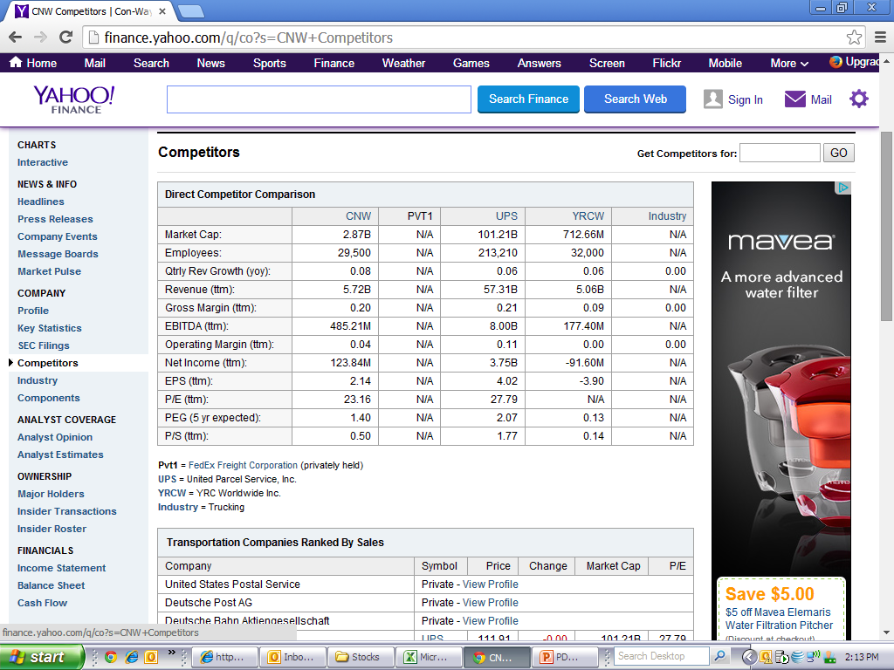
Profile 2 – CNW is a distant No. 3+ after Fedex and UPS, gross margins similar to UPS, PEG 1.4 better than UPS, similar P/E, P/S low, UPS scale provides better Ops margin

Slide 5
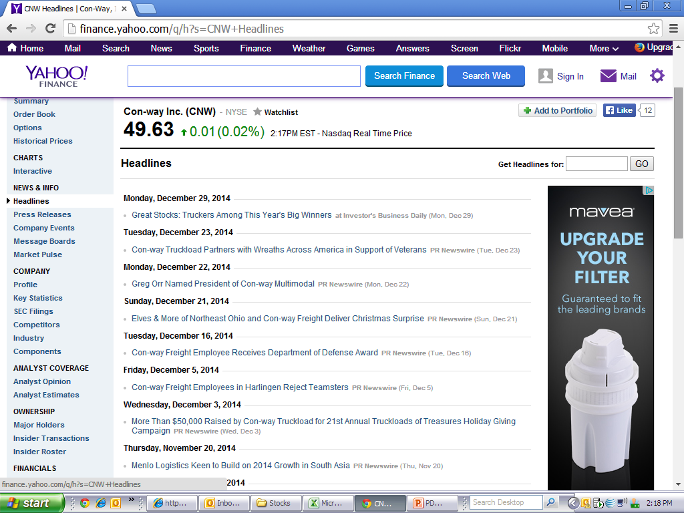
Recent News – Positive headline news, 2014 “winners”, Veterans support, good earnings, DOD award, CNBC pundits said trucking was due for increased earnings in 15 (Dec 31)

Slide 6
Key Stats
RCL UPS
Trailing P/E =23 (fully valued) 27.8
Forward (5 yr) P/E=17.4 (LT BUY) 19.8
PEG(5 yr)= 1.4 Med BUY 2.1
Debt/Equity=60 (Low vs UPS) 218
Short Float %= 3.9 (No squeeze) 1.6
Book Value = $21.8/sh 6.2
Current P/E comparable to best in sector UPS
Future – Med long term buy with a 17.4 P/E and w/PEG of 1.4
Profit margins similar to UPS
Gross profit s tripled over 2013-14 yrs, expect to continue in 15
Operating & net income 4X increasing over 2013-14, expect to continue in 15
Selling , operations & other costs flat over 2013-14
Low debt vs UPS

Slide 7
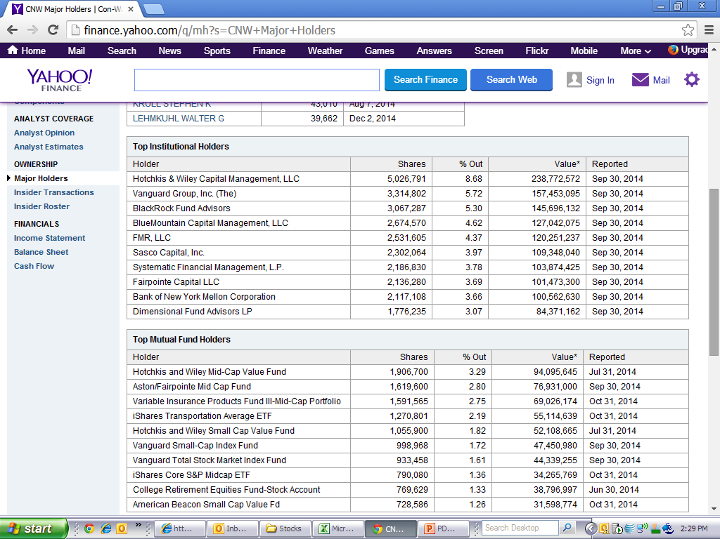
Good list of large institutional investors – they will likely drive how the stock behaves, no whales or activists

Slide 8
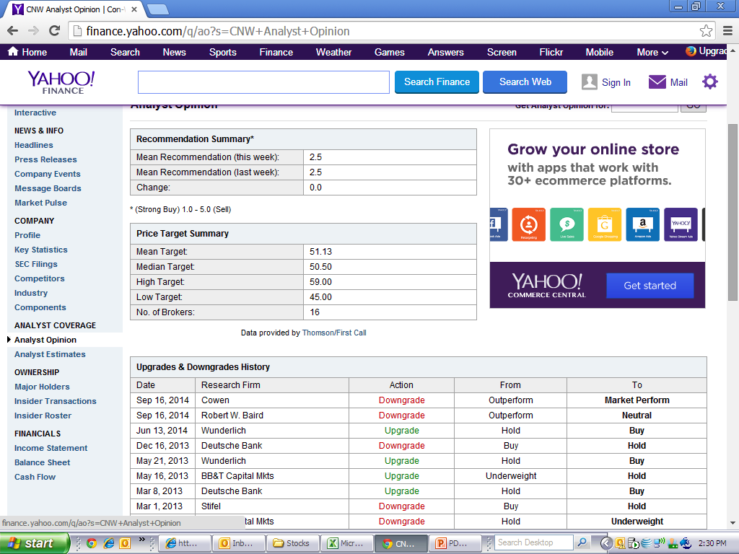
Analysts – Close to fully valued, neutral/hold

Slide 9
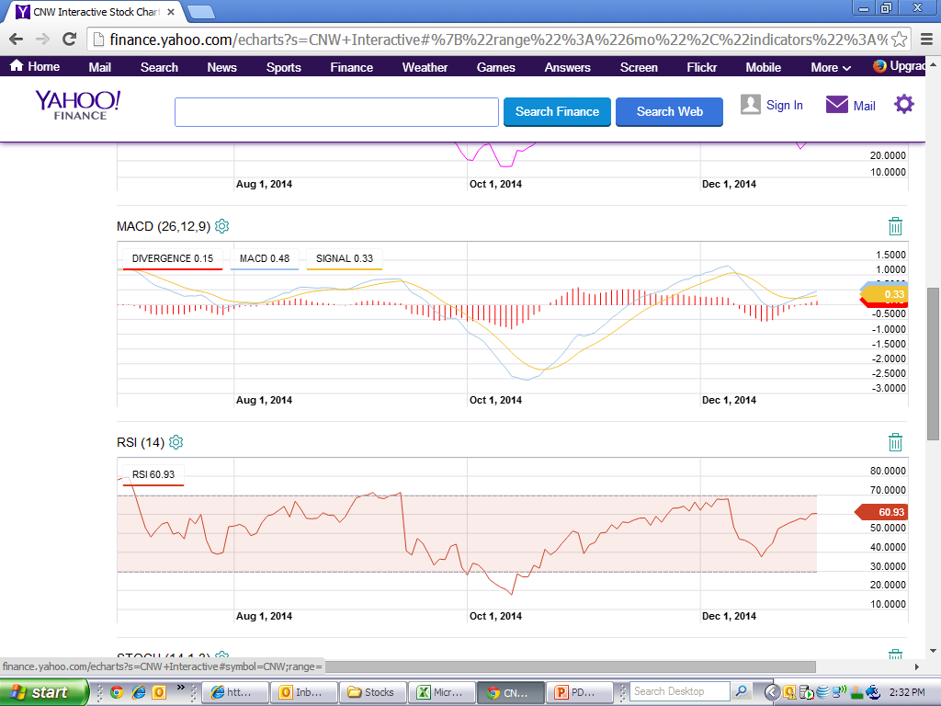
Tech Stats
CNW (6 mo view)
Stock price is wedging, slopes indicate a break higher is more likely (from 50)
Recent (6 mo) trough is ~40 (support), resistance recent high ~53, price target 50-51
Above the 50 day moving aver
MFI – 44 and trending up (positive)
MACD – flat trend (neutral)
RSI – 60 (70 is overbought) neutral to overbought

